Slide 1
ContinuoUs integration
Fernando Pombeiro
Notes:
Change backfround to

Slide 2

Why should you care?
Because you are all future C-level executives
Because this is what your companies are growing in to
Because this is how the best companies operate.
Because this stuff works.

Slide 3

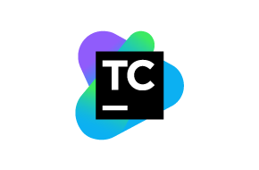
What we’ll be covering
Dev/Ops- A quick overview
Continuous Integration defined
How Continuous Integration fits into the Software Development Life Cycle
Unit tests and build agents
Games CI
Practical tool review:
Jenkins
TeamCity

Slide 4
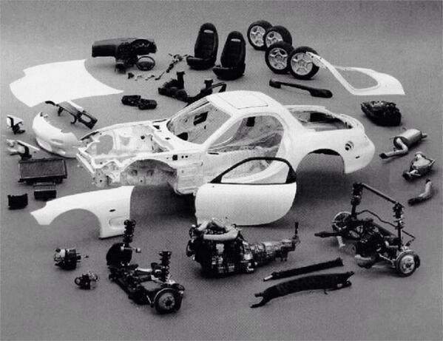
What your code looks like living in your version control system

Slide 5

What your code looks like when it works

Slide 6

How much can you mess with this car?

Slide 7

Dev ops: the old school methods
The role of Operations is to ensure stability. They must ensure that production works at all times.
The role of developers is to ensure constant change- they update, advance, and alter the code base constantly.
How do we get a handle on these opposing facets of software development?
Notes:
As recently as ten years ago there was common practice that software development was split into two distinct camps:
The Developers: the folks who create code on computers and
The Ops Team: the folks who manage those computers.
The OPS teams are concerned with stability whereas the Developer team is concerned primarily with change.
This can create tension between the two teams…

Slide 8

Ops and dev in conflict
The ”Giant machine” metaphor
How do we change the machine constantly whilst simultaneously “keeping it safe”?
How do we alter the state of the machine without breaking it?
“Everyone holds the pager” –Peter Chapman
Notes:
How do we deal with the tension between stability (required by operations) and constant change?
How do we make sure that code coming from these constant changes actually integrates effectively? How do we make sure that the boxes don’t break the giant machine?
This is where Continuous Integration comes in! This is how we “protect the box”

Slide 9
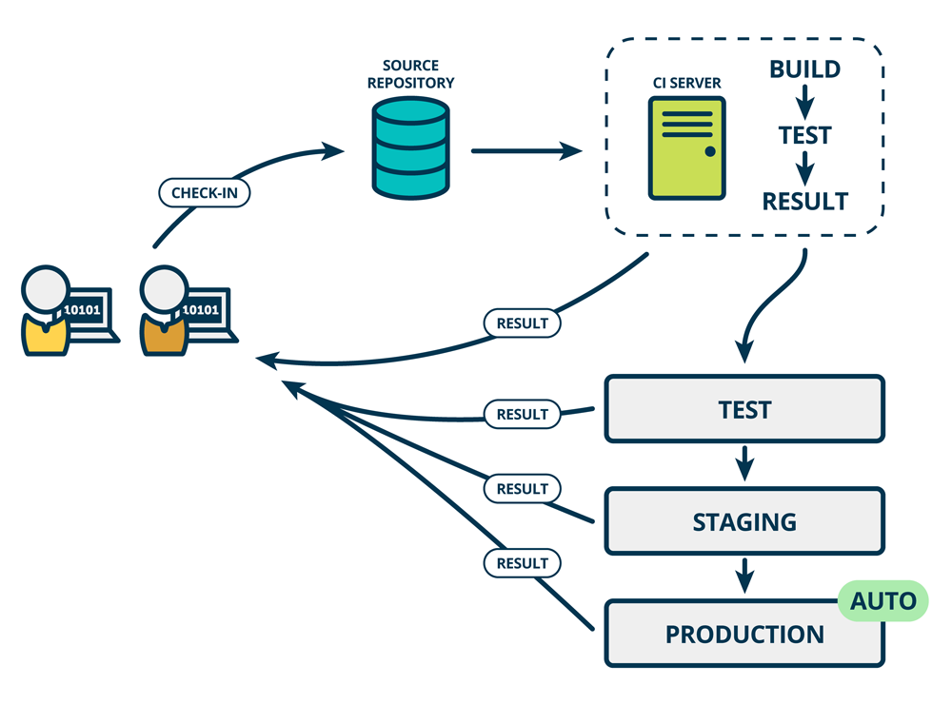
The ecosystem: Devops
DevOps (a clipped compound of DEVelopment and OPerationS) is one of the fastest-growing areas in the programming and development world
The concept came out of a meeting between Patrick Debois and Andrew Schafer at an Agile conference in 2008. The meeting led to spirited discussions around the best way to continuously deploy software.

Slide 10
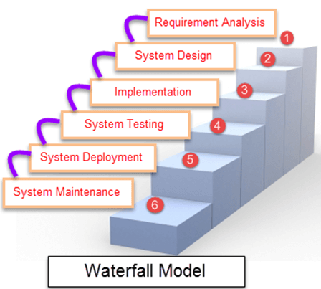
DEVOPS to continuous integration
Continuous Integration is intended as a way to avoid the pitfalls of things like waterfall development.
In the waterfall development paradigm you change large parts of the “bond car” and then put them all in at once.
This requires extensive testing
Notes:
A big part of breaking down this metaphorical “wall” meant breaking ourselves from some bad process habits.
The traditional way of doing software development in the past was the waterfall method. In very simple shorthand it means:
Finish ticket 1
Finish ticket 2
Finish ticket 3
This means that you organize your sprints very rigidly and every 2-3 weeks you do a massive code push between development and production.

Slide 11
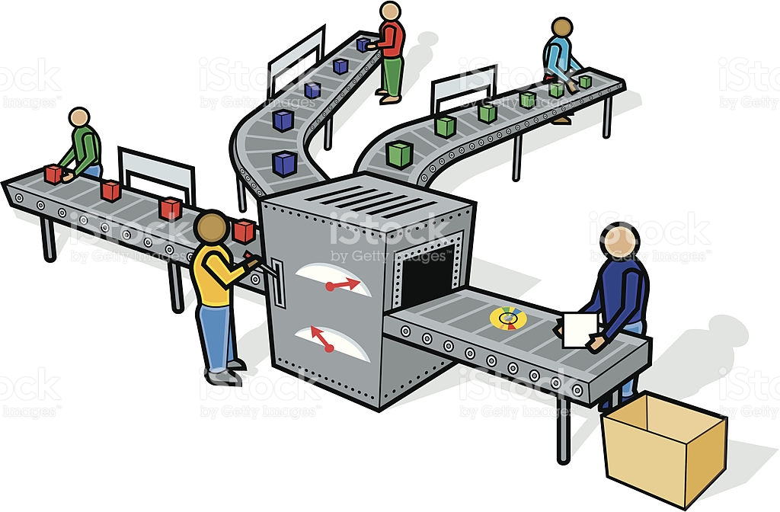
Devops to continuous integration
How do we control the flow of work going into our production machine?
How do we keep it constant?
Notes:
Copyrighted photos? Watch out.
Under our new paradigm (working “without walls”) we want a single worker to be able to push work to our “production machine” from the beginning of the assembly line to the end (giant machine metaphor)
The issue here is that, of course, not everyone pushes at the same speed.
We don’t want to collect a bunch of work and wait to push it to the production machine at the same time! Why? Because we run into the problem of people waiting for ops to work.

Slide 12
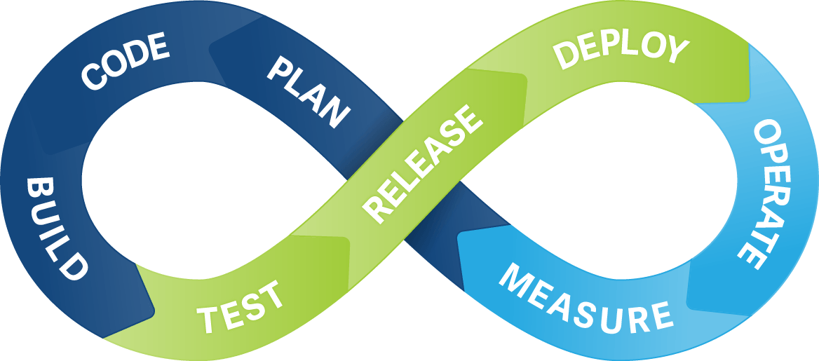
Devops to continuous integration
Constant change means that the production code can be updated at all times
As our coders push constantly the integration into production is continuous.
Notes:
To solve for this conundrum we want the “production machine” to be able to take on new code at various times.
Instead of pushing code in “batches” every 2-3 weeks- imagine if we can push small changes constantly to production!
This would then help create a culture where everyone pushed their code to production on their own- without the necessity of operations ‘guarding’ the machine.
This, in a nutshell, is the continuous part of continuous integration.

Slide 13

Devops to continuous integration
“Continuous Integration is a software development practice where members of a team integrate their work frequently, usually each person integrates at least daily - leading to multiple integrations per day. Each integration is verified by an automated build (including test) to detect integration errors as quickly as possible. Many teams find that this approach leads to significantly reduced integration problems and allows a team to develop cohesive software more rapidly."
-Martin Fowler, 2008

Slide 14
DEVOPS to continuous integration
Now let’s address Integration:
The car scenario
Testing each piece
Bringing it together
Keeping the constant flow of work
Notes:
So now let’s talk about the integration side.
If we have, say, 25 people working on different parts of a machine- how do we make sure that each of the unique parts works together?
Keep in mind that each of these 25 people are working on their own small “piece” of the machine (like spark plugs on a car).
The old model of batch integration- make a staging server version with all changes- push to production.
So how do we make sure that everything ”works together” AND keep that constant flow?

Slide 15


Slide 16
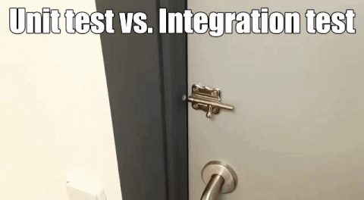

Slide 17

Continuous Integration and Games Development
Regression testing vs. Unit Testing:
In games development it is difficult to write a test in which the results of a unit test are set to match a pre-ordained answer by the code writer.
Imagine stating that “if I hit the cue ball the 9 ball must go into the corner pocket or this code fails”
Regression testing basically takes historical data from a previous, successful build and compares it against a new build:
If I hit the cue ball at the exact same angle at the exact same force as I did previously- does it still go into the right pocket?

Slide 18
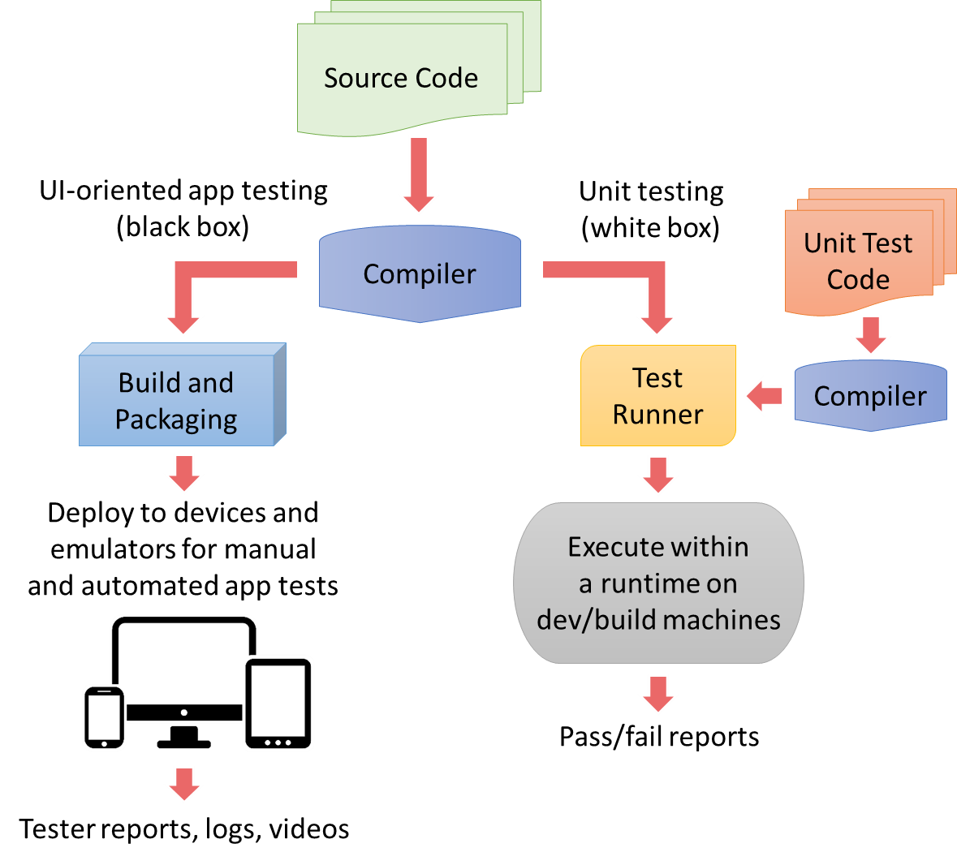
Regression Testing Frameworks
Unity comes with a regression testing framework in the Runtime test framework in Unity Tests
Setting up Regression Testing is time consuming and difficult but one of the best ways to prevent from shipping buggy games.
They can compare, pixel by pixel, the current build against previous builds to check on the effects of the changes.
Some examples of CI servers for games:
Hudson
Cruisecontrol.NET
BuildBot

Slide 19
Regression Testing Frameworks
Regression tests should rely on deterministic behavior (i.e: Random generators in the game should not be tested)
Regression tests should avoid Frame-rate dependencies. Make sure you run rendering and simulation loops with a constant virtual frame rate.
Try to keep a strict separation between UI and production tests.
Notes:
Courtesy of https://www.gamasutra.com/view/feature/130682/automated_tests_and_continuous_.php For instance, a pathfinding system that uses randomness to make the decisions of characters less predictable could provide a public method for initializing the seed. This method could then be used by the tests to ensure that the characters always take the same path.

Slide 20
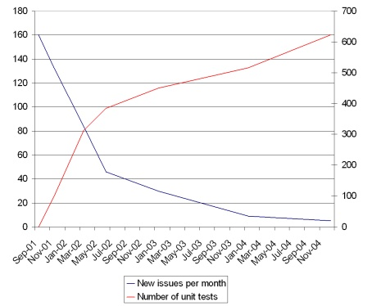
Continuous Integration in games
Notes:
Courtesy of https://www.gamasutra.com/view/feature/130682/automated_tests_and_continuous_.php For instance, a pathfinding system that uses randomness to make the decisions of characters less predictable could provide a public method for initializing the seed. This method could then be used by the tests to ensure that the characters always take the same path.

Slide 21

Devops and CI: keeping the flow moving
So how do we keep the flow going in this state of constant change?
Remember- Ops folks were primarily concerned with stability. If I am going to work on a copy of my “production machine” I need that machine in some stable state.
If 24 of my other coworkers are constantly changing that machine- what state is it in? If I grab a copy of it on Wednesday- how do I know that my changes will work on Friday (after my co-workers have altered it)?
How do we solve this?

Slide 22
A quick side note about version control
So this “machine” that the ops team traditionally guards is usually known as the “source control” server.
The purpose of the source control server (usually git or something like it) is to keep a “single source of truth” for all of the code currently running on the production machine.
The “main branch” (usually called the “master branch”) should always match the code currently running on your production machine.

Slide 23
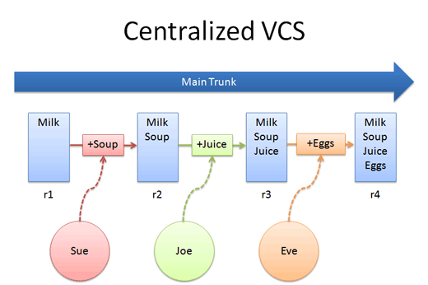
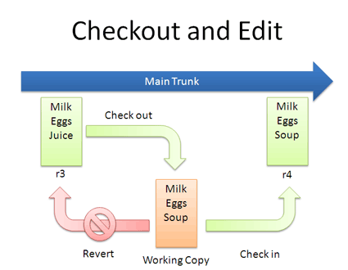
A quick side note about version control

Slide 24
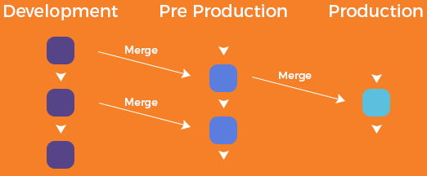
A quick side note about version control

Slide 25
Devops and CI: keeping the flow moving
TeamCity Video
This is the idea around CI- that we should have an automated server that tests our code before it is added to production.
Peer feedback is essential to this process.
Notes:
Feedback loop is immediate. Also- peer review has to be part of this.
Often times this server will also deploy the code from the master branch to production upon detecting a change. (This is Continuous Deployment)
The idea here is that we are automating the “code check” jobs usually reserved for the old “Ops” folks
Also- we are keeping the developers accountable for all of their code!
(No more ”throwing boxes over the wall!”)

Slide 26
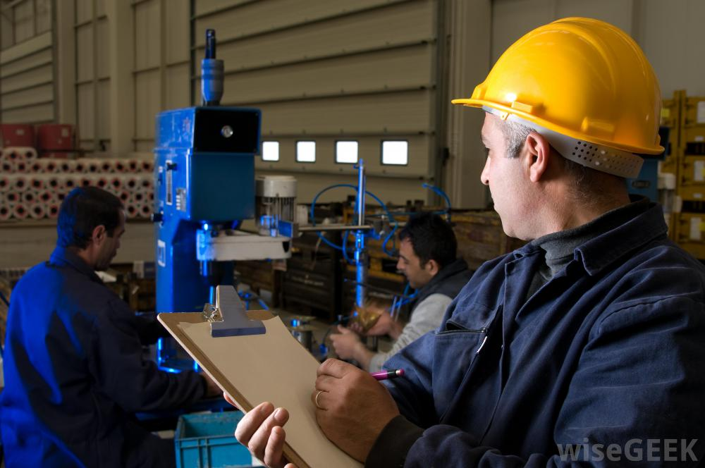
Devops and CI: keeping the flow moving
So how do these CI systems work?
They deploy “build agents”.
These ”build agents” essentially run your code and tell you what (if any) tests are failing.
Think of them as little QA engineers with clipboards: they critique everything you are submitting and turn in a report to you.
They can run anything from
Unit tests
Integration tests
Linters
Notes:
Examples of Linters – static checkers (linters) are something else.

Slide 27
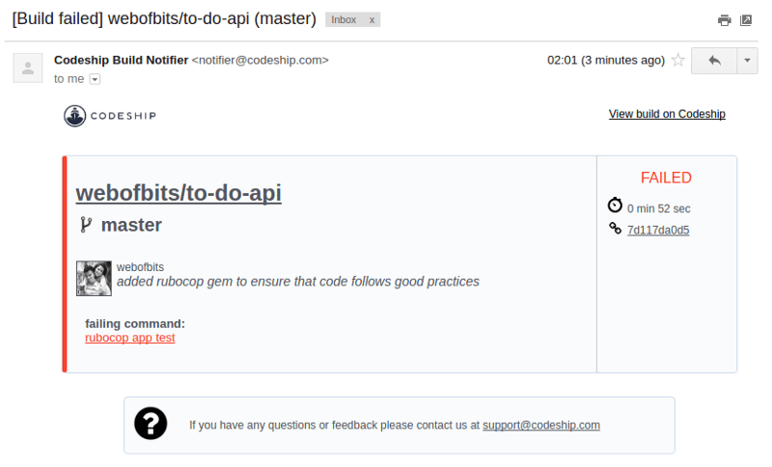
Failed report (usually about 2 minutes after code push)

Slide 28



Different ci tools
Notes:
Add in the Microsoft integration server. TeamFoundation server.

Slide 29
Ways to use ci tools
Obviously there are several ways to set up your CI server. Some considerations:
Should it auto-deploy to a staging server with each new commit?
What tests should it run?
How do we measure “coverage” of tests?
Are there any tweaks with my particular environment that I might want to run?
Notes:
Staging server- keep it consistent and define what the staging server is.

Slide 30

CI tools: build agents
So we’ve mentioned that Build Agents are like the guys with clipboards on the manufacturing floor. They are obviously controlled by a Build Controller who deploys them to crawl over new code, run it, and make sure that it will integrate into the production machine.
Build agents are something else that you can customize to your environment that will help out with code integration.
Notes:
Diagram would help;

Slide 31
Why does any of this matter to you?
As you build out your company you are going to want to institute engineering principles that allow swift and efficient application development.
Right now the industry standard is to aim for “as many deployments per day as possible”
Continuous Integration servers are essentially the guard rails that allow you to push code constantly.

Slide 32
CI in broad context
So why does CI work in a DevOps environment?
It creates a safe system for developers to push their code
It allows for the developer to be responsible for end to end code production
It helps push accountability to developers.
Notes:
It also forces your developers to write tests which forces them to think not only about how their code works in isolation but how it works as part of the entire system.
From a management perspective this is an essential tool to ensuring that you keep that metaphorical “wall” from forming between Dev and Ops.

Slide 33

So where do we go from here with CI?
What we’re seeing in the tech world is a new emphasis on swifter, smaller, faster; things like microservices are basically packaging environments around certain specific, small operations
Notes:
For example: imagine that I have a small bit of code that sends an email and requires, say, Python3, an SMTP library, and runs on Linux machines…
Wouldn’t it be cool if I could just have a little package that surrounds that code, installs all of those packages in a little box, and runs the code in the box successfully?
CI helps you out on this by running each of those boxes.

Slide 34

CI: the future
So- for future CTOs- you have to ask yourself where CI is going to fit into your organization
Setting up the CI server takes time and resources (and like everything else- there is a maintenance cost)
You will have to decide what to test for and when and how difficult you are going to make pushing to master
Too difficult? You kill productivity.
Too lax? You break things. A lot.
Notes:
Talk about the gold standard- where we are and where we are going. Worth considering where we are building.

Slide 35

CI: the future
As CTOs you need to measure your software productivity.
Integrations and deployments allow you two excellent KPIs to measure the success of your engineering team.
Successfully achieving CI/CD means a more efficient, smooth, effective process.
Notes:
Talk about the gold standard- where we are and where we are going. Worth considering where we are building.

Slide 36

Confused? Good…..ask questions!

